Slide 1
Natural Language Processing
Lecture 3: Basic Text Processing

Slide 2
Basic Text Processing
Word Tokenization
Word Normalization
Lemmatization
Morphology
Stemming
Sentence Segmentation
Regular Expressions

Slide 3
STEMMING
STEMMING -> STEM

Slide 4
Stemming
Reduce terms to their stems in information retrieval
Stemming is crude chopping of affixes
language dependent
e.g., automate(s), automatic, automation all reduced to automat.
for example compressed
and compression are both
accepted as equivalent to
compress.
for exampl compress and
compress ar both accept
as equival to compress

Slide 5
Stemming
Input: a word
Output: the word’s stem (approximately)
Examples from the Porter stemmer:
-sses → -ss
-ies → i
-ss → s

Slide 6
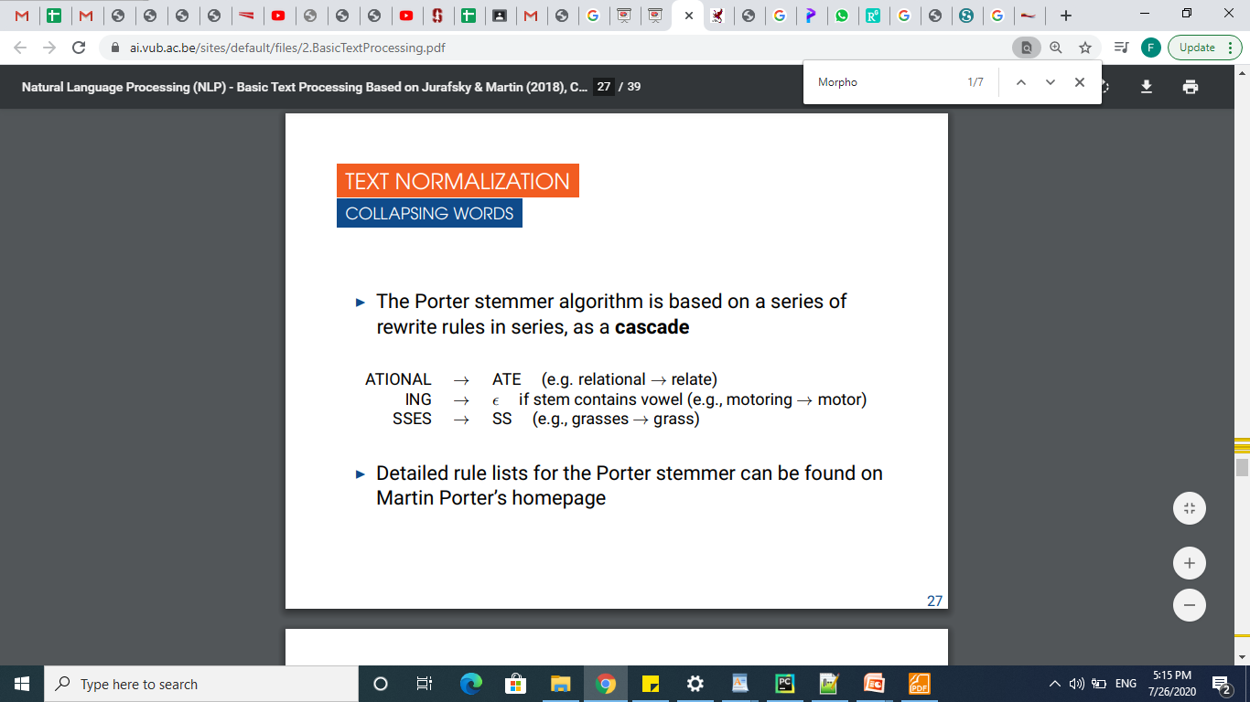
Porter Stemmer
The Porter stemmer algorithm is based on a series of rewrite rules in series, as a cascade
ATIONAL → ATE (e.g. relational → relate)
ING → if stem contains vowel (e.g., motoring → motor)
SSES → SS (e.g., grasses → grass)

Slide 7
Porter’s algorithm The most common English stemmer
Step 1a
sses → ss caresses → caress
ies → i ponies → poni
ss → ss caress → caress
s → ø cats → cat
Step 1b
(*v*)ing → ø walking → walk
sing → sing
(*v*)ed → ø plastered → plaster
…
Step 2 (for long stems)
ational→ ate relational→ relate
izer→ ize digitizer → digitize
ator→ ate operator → operate
…
Step 3 (for longer stems)
al → ø revival → reviv
able → ø adjustable → adjust
ate → ø activate → activ
…

Slide 8
SENTENCE SEGMENTATION

Slide 9
Sentence Segmentation
Sentence segmentation is another important step in text processing
The most useful cues are punctuation (periods, question marks, exclamation points)
Periods can be ambiguous: Mr. or Inc.
Sentence boundary
Abbreviations like Inc. or Dr.
Numbers like .02% or 4.3
In general, sentence tokenization methods work by building a binary classifier that decides if a period is a part of the word or is a sentence-boundary marker

Slide 10
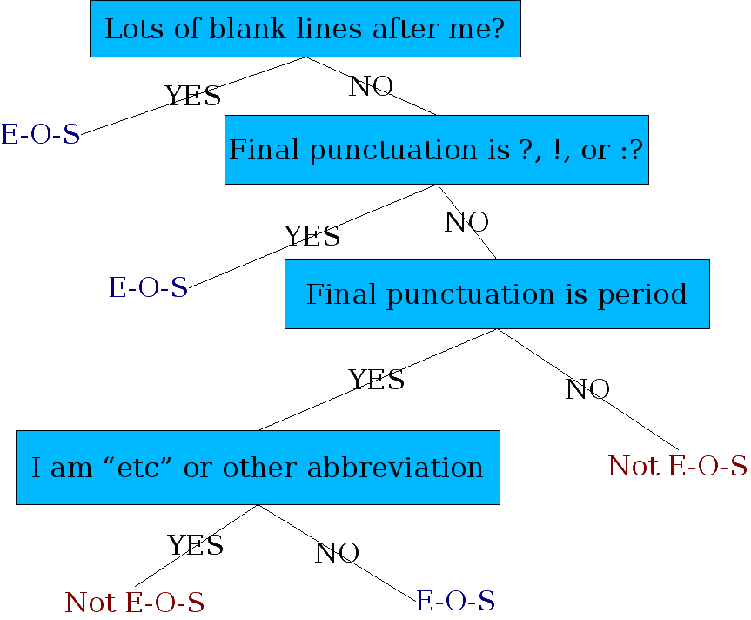
Determining if a word is end-of-sentence: a Decision Tree

Slide 11
More sophisticated decision tree features
Case of word with “.”: Upper, Lower, Cap, Number
Case of word after “.”: Upper, Lower, Cap, Number
Numeric features
Length of word with “.”
Probability(word with “.” occurs at end-of-s)
Probability(word after “.” occurs at beginning-of-s)

Slide 12
Implementing Decision Trees
A decision tree is just an if-then-else statement
The interesting research is choosing the features
Setting up the structure is often too hard to do by hand
Hand-building only possible for very simple features, domains
For numeric features, it’s too hard to pick each threshold
Instead, structure usually learned by machine learning from a training corpus

Slide 13
REGULAR EXPRESSIONS

Slide 14
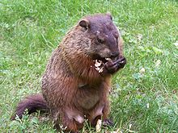
Regular Expressions (RE)
A formal language for specifying text strings
How can we search for any of these?
woodchuck
woodchucks
Woodchuck
Woodchucks

Slide 15
Types of Characters in RE
There are two types of characters in RE
Literal
Every normal text character is an RE, and denotes itself.
Meta-characters
Special characters that allow you to combine REs in various ways
Example:
a denotes a
a* denotes ε or a or aa or aaa or ...

Slide 16
Regular Expressions: Disjunctions
Letters inside square brackets []
Ranges [A-Z]
Pattern | Matches
[wW]oodchuck | Woodchuck, woodchuck
[1234567890] | Any digit
Pattern | Matches
[A-Z] | An upper case letter | Drenched Blossoms
[a-z] | A lower case letter | my beans were impatient
[0-9] | A single digit | Chapter 1: Down the Rabbit Hole

Slide 17
Regular Expressions: Negation in Disjunction
Negations [^Ss]
Carat means negation only when first in []
Pattern | Matches
[^A-Z] | Not an upper case letter | Oyfn pripetchik
[^Ss] | Neither ‘S’ nor ‘s’ | I have no exquisite reason”

Slide 18
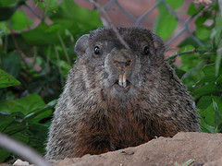
Regular Expressions: More Disjunction
Woodchucks is another name for groundhog!
The pipe | for disjunction
Pattern | Matches
groundhog|woodchuck
yours|mine | yours mine
a|b|c | = [abc]
[gG]roundhog|[Ww]oodchuck
Photo D. Fletcher

Slide 19
Regular Expressions: ? * + .
Pattern | Matches
colou?r | Optional previous char | color colour
oo*h! | 0 or more of previous char | oh! ooh! oooh! ooooh!
o+h! | 1 or more of previous char | oh! ooh! oooh! ooooh!
baa+ |  | baa baaa baaaa baaaaa
beg.n |  | begin begun begun beg3n

Slide 20
Anchors
Constrain the position(s) at which a pattern may match
Think of them as “extra” alphabet symbols, though they actually match ε (the zero-length string)
/^a/ Pattern must match at beginning of string
/a$/ Pattern must match at end of string
/\bword23\b/ “Word” boundary
/\B23\B/ “Word” non-boundary
Notes:
\b is also used as the backspace control sequence. Thus in order for the regular expression engine to interpret the word boundary correctly, you need to escape the sequence:

Slide 21
Regular Expressions: Anchors ^ $
Pattern | Matches
^[A-Z] | Palo Alto
^[^A-Za-z] | 1 “Hello”
\.$ | The end.
.$ | The end? The end!

Slide 22
Optionality and Repetition
/[Ww]oodchucks?/ matches woodchucks, Woodchucks, woodchuck, Woodchuck
/colou?r/ matches color or colour
/he{3}/ matches heee
/(he){3}/ matches hehehe
/(he){3,} matches a sequence of at least 3 he’s

Slide 23
Operator Precedence Hierarchy
1. Parentheses ()
2. Counters * + ? {}
3. Sequence of Anchors the ^my end$
4. Disjunction |
Examples
/moo+/
/try|ies/
/and|or/
Notes:
Because counters have a higher precidence than sequence, this matches mooooooo.
The second one probably does not do what is expected – would match try or ies, but not tries.
The third does work as expected.

Slide 24
A Simple Exercise
Write a regular expression to find all instances of the determiner “the”:
/the/
/[tT]he/
/\b[tT]he\b/
/(^|[^a-zA-Z][tT]he[^a-zA-Z]/
The recent attempt by the police to retain their current rates of pay has not gathered much favor with the southern factions.

Slide 25
A Simple Exercise
Write a regular expression to find all instances of the determiner “the”:
/the/
/[tT]he/
/\b[tT]he\b/
/(^|[^a-zA-Z][tT]he[^a-zA-Z]/
The recent attempt by the police to retain their current rates of pay has not gathered much favor with
southern factions.

Slide 26
A Simple Exercise
Write a regular expression to find all instances of the determiner “the”:
/the/
/[tT]he/
/\b[tT]he\b/
/(^|[^a-zA-Z][tT]he[^a-zA-Z]/
The recent attempt by the police to retain their current rates of pay has not gathered much favor with the southern factions.

Slide 27
A Simple Exercise
Write a regular expression to find all instances of the determiner “the”:
/the/
/[tT]he/
/\b[tT]he\b/
/(^|[^a-zA-Z][tT]he[^a-zA-Z]/
The recent attempt by the police to retain their current rates of pay has not gathered much favor with the southern factions.

Slide 28
A Simple Exercise
Write a regular expression to find all instances of the determiner “the”:
/the/
/[tT]he/
/\b[tT]he\b/
/(^|[^a-zA-Z][tT]he[^a-zA-Z]/
The recent attempt by the police to retain their current rates of pay has not gathered much favor with the southern factions.

Slide 29
A Simple Exercise
Write a regular expression to find all instances of the determiner “the”:
/the/
/[tT]he/
/\b[tT]he\b/
/(^|[^a-zA-Z])[tT]he[^a-zA-Z]/
The recent attempt by the police to retain their current rates of pay has not gathered much favor with the southern factions.
Notes:
The \b counts words as any sequence of digits, undercores, or letters. Suppose you wanted to find “the” in the context of _the or the28.
Could you write that one.
Last one: either it starts a line, or the thing in front of it is not a letter; followed by either t or T; followed by he where the following character is not a letter.

Slide 30
Example
Find me all instances of the word “the” in a text.
the
Misses capitalized examples
[tT]he
Incorrectly returns other or theology
[^a-zA-Z][tT]he[^a-zA-Z]

Slide 31
Errors
The process we just went through was based on fixing two kinds of errors
Matching strings that we should not have matched (there, then, other)
False positives (Type I)
Not matching things that we should have matched (The)
False negatives (Type II)

Slide 32
Errors cont.
In NLP we are always dealing with these kinds of errors.
Reducing the error rate for an application often involves two antagonistic efforts:
Increasing accuracy or precision (minimizing false positives)
Increasing coverage or recall (minimizing false negatives).

Slide 33
Regular Expression in Python
Module re
import re
Search the string to see if it starts with "The" and ends with "Spain":
import re txt = "The rain in Spain" x = re.search("^The.*Spain$", txt)

Slide 34
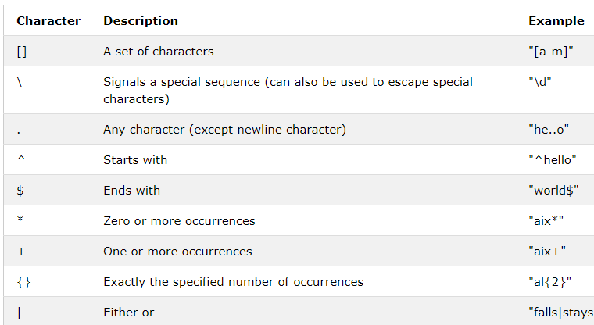
Regular Expression in Python

Slide 35
Summary
Regular expressions play a surprisingly large role
Sophisticated sequences of regular expressions are often the first model for any text processing text
For many hard tasks, we use machine learning classifiers
But regular expressions are used as features in the classifiers
Can be very useful in capturing generalizations

